Slide 1
10th National Virtual Conference
Fostering Human Resilience – Catalyst for Management, Science and Technology
8th and 9th October 2021
Organized by
Anekant Education Society’s
Anekant Institute of Management Studies (AIMS), Baramati
In association with
All India Council for Technical Education (AICTE)

Slide 2
Dr. Sarang Shankar Bhola Associate Professor and HOS Management, KBPIMSR, Satara
Technical Session
Day 1
8th October 2021

Slide 3
Quality Research

Slide 4
Context: Tier-II: Lets take few questions
In general
Do you think researcher/teachers have value in the society?
Why teachers are not supported by society on their demands?
What society talks only of teachers salaries ?
To be specific
Do we as a researcher/teacher has impactful outcomes?
Do we really contribute to society and Industry through our research?
Do we really help our students reach their goals/achieve their dreams?
Does stakeholders have faith in existing education system?
Why rules/norms of research changing so many times ?
Why in research we are not at international front ?

Slide 5
Take Away
Quality Research
Approach to quality research
Shift the focus
Paradigm shifts in research
Triangle of Generalization
Rethinking on Process of Research

Slide 7
Tier – II Research
2020 Onwards
Model Building Survey
2015 - 2020
Ho Testing Survey
CFA
SEM
1995 - 2015
Primary Data Survey
GAP Analysis
Prior 1995
Problematization?
Ontology
Epistemology
Secondary Data Survey

Slide 8
Present Scenario of Research
What are we doing at Present
Topic Selection
Gap Analysis
What Actually we need to do
Problematization
Pilot Testing
Copy Best Paper
Stereotyping or proliferation
Mere survey reports.
Model Building
Generalization of Research
We generally end up with where we actually should have been started.
We end up with nothing NEW in outcomes; the outcomes are but Obvious.

Slide 9
Process of Research
Input
Problematization
Model Building
Process
Pilot
Errorless Research
Output
Generalization
Re-Pilot
Model Testing's
Model (S)
Prescriptions to problems.
Ethnographic Research
40%
40%
20%

Slide 10
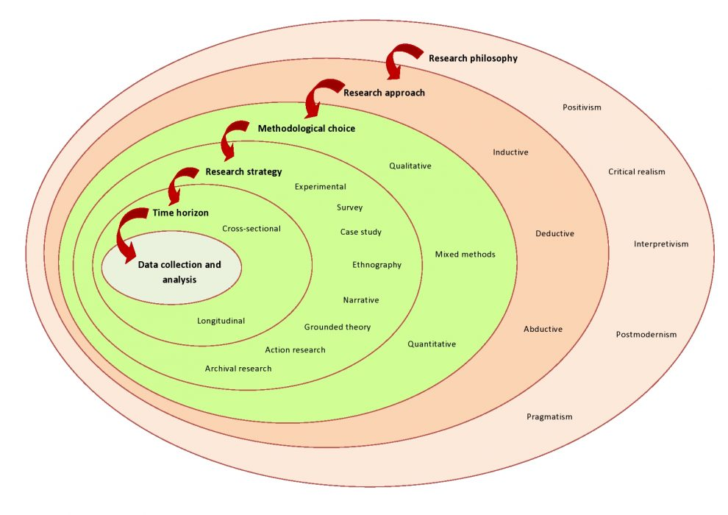
Saunders Research Onion¹

Slide 11
Publication Focus
Indian
Monograph
Policy Documents
National News papers
Blogs
Reference Books
Patent
Copyright
SAGE
Francis & Taylor
Web of Science
Emerald
FT - Fifty
ABDC
Scopus
International

Slide 12
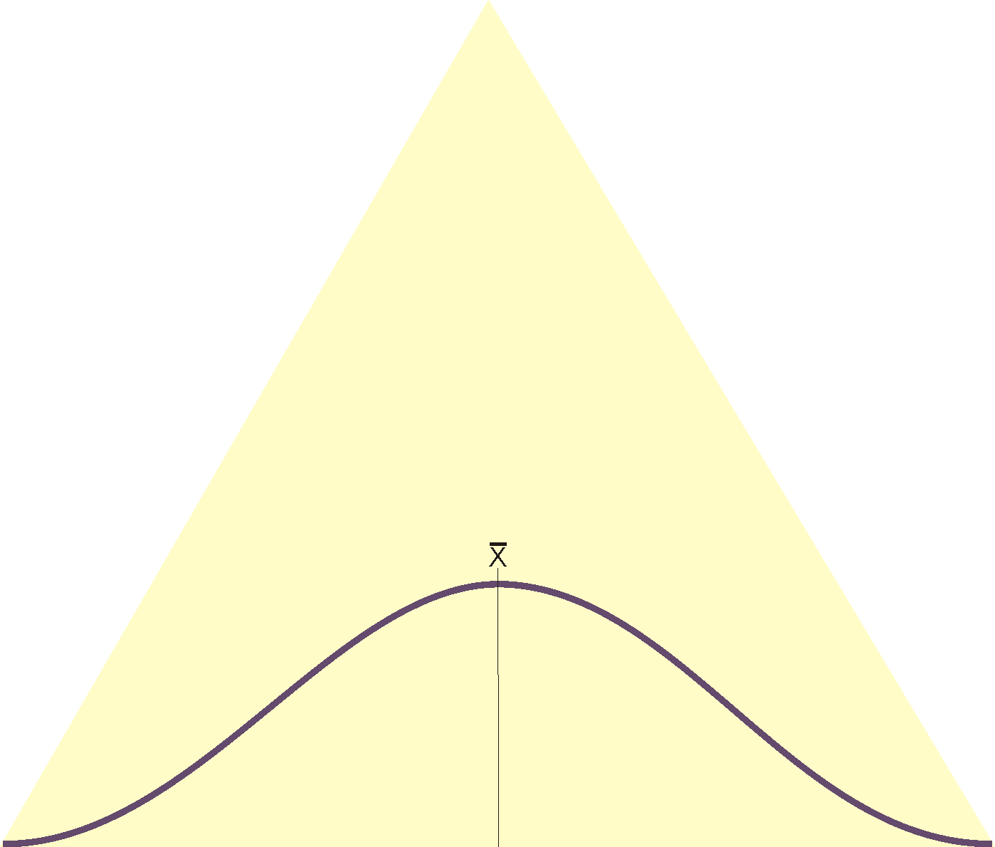
Triangle of Generalization
Face
Test – Re-test
Content
Validity
Reliability
Equivalent Forms
Criterion
Internal Consistency
Construct
Normality
Z – SK – S.E.
KS-SW test
Central Limit Theorem

Slide 13
Shift in Spotlight
Research Quantity
Publications in Numbers
Number of likes on face book
Number of text books published
Spotlight syndrome
Self declared experts
Google citations

Slide 14
Quality Research
Publication in Internationally acclaimed journals only.
No Spotlight syndrome
IPR
Reference Books
Case Development
Scopus ‘H’ Index
Orchid

Slide 15
Research Quantity
Quality Research
Publications in Numbers
Number of likes on face book
Number of text books published
Spotlight syndrome
Self declared experts
Google citations
Publication in Internationally acclaimed journals only.
No Spotlight syndrome
IPR
Reference Books
Case Development
Scopus ‘H’ Index
Orchid

Slide 16
Perfectionist
Amir Khan
Nagraj Manjule

Slide 17
Research Culture
1. Collaborative research
2. Interdisciplinary research
3. International collaborations of researchers
5. Plagiarism Free research
6. Model building – testing – retesting
Intellectual property rights: Invent – Innovate – Incubate.
Focus on one research domain – do not deviate.
Be present on the research online domains – Research Gate, Academia, SSRN, Google Scholar, Orchid and the like.
An ECO System of RESEARCH

Slide 18
Research Problems of New Horizon
Sustainable business model.
Green Business Strategies
Digital Business
Changes in behavior of consumers owing to pandemic.
Changing business models.
Rural development
Agro processing based entrepreneurship.
Issues bottom of the pyramid
The ways and means to uplift people below poverty line.
Ways to bring artisans and village cottage industry at national and international markets.
Ways to attain full employment in nation.
Ways to Productive utilization of nature resources to its optimum extent.
How to cultivate the entrepreneurial eco system in society.

Slide 19
Resilience: Bounce back
9% in 396 Towns
14% in 4738 Towns
Bottom of the pyramid 70% in
6 lakhs Villages of India
7%
17
Cities
BPL
Prof. C.K.Pralhad
Baba Amte
Dr. Prakash Amte
Medha Patkar
Dr. Abhay Bang
Dr. Muhammad Yunus
Prof. Amartya Sen
NAAM Foundation
Jal Shakti Abhiyan

Slide 20
References
https://www.google.com/search?q=research+onion+saunders&sxsrf=AOaemvI8Pjqj5tLbzH3NjUWq_VEQStbo9w:1633061078918&source=lnms&tbm=isch&sa=X&ved=2ahUKEwiC-YTMqqjzAhVcxzgGHZEvAi0Q_AUoAXoECAIQAw&biw=1366&bih=596&dpr=1#imgrc=V60wq5ig6WUXwM, 01.10.2021, 9.15am.

Slide 21
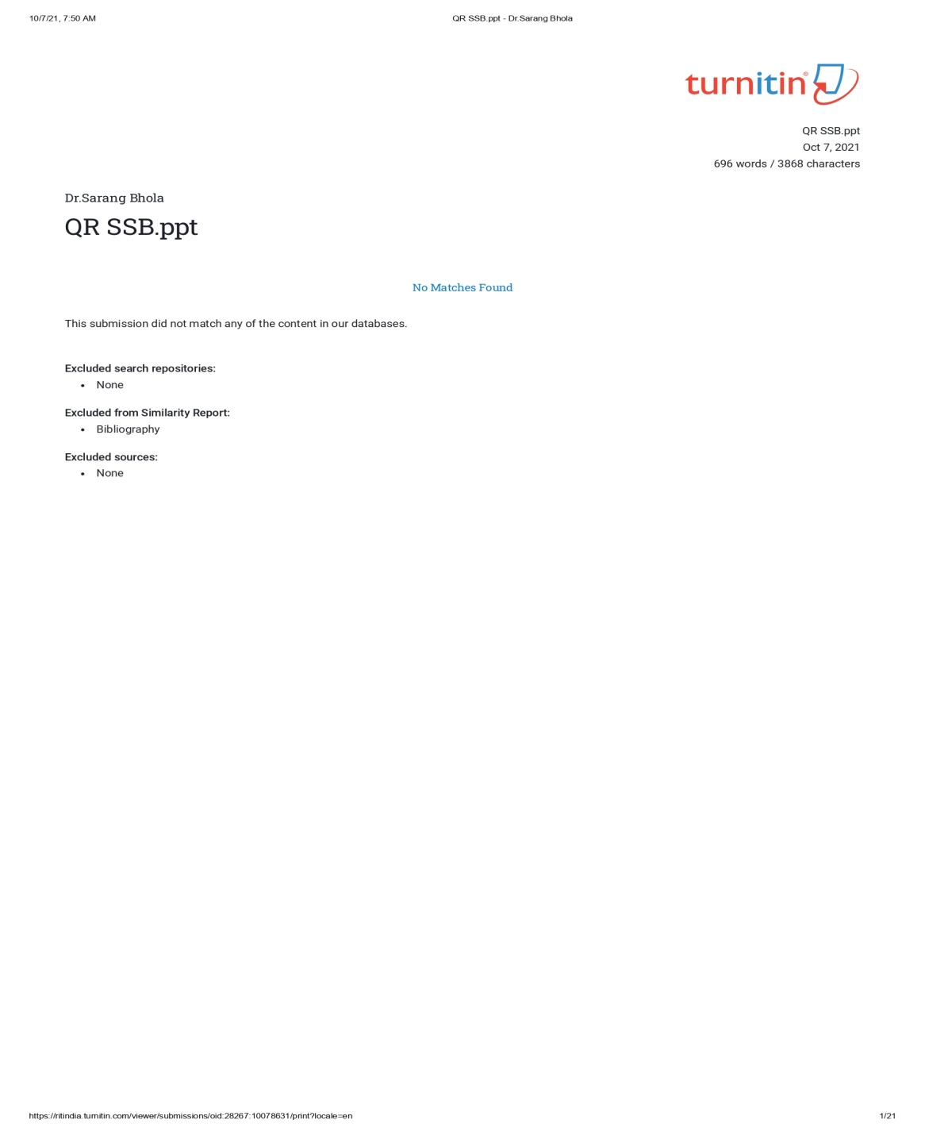

Slide 22
Discussion
www.sarangbhola.com

