Slide 1
Motivation
Sarang Bhola
Associate Professor,
Karmaveer Bhaurao Patil Institute of Management Studies and Research,
Satara.

Slide 2
WHY this topic ?
WHAT it is about ?
HOW to get over there ?

Slide 3
Takeaways
Real Heroes – Motivational Source
Basics of Motivation
Self Evaluation of Goals
Getting Over Frustration
Thumb Rules – to remain motivated
Your Own LOC
Video of Sakshi Malik Rio Olympic match for Bonze medal …

Slide 4
Real Heroes: Most Motivated People
Sakshi Malik, PV Sindhu
Jiva Mahal, Shiva Kashid for Chh. Shivaji Maharaja
Laxmibai Patil – Rayat Shikshan Sanstha
Indian Soldiers
Nagare Patil – Taj Attack

Slide 5
Motivation
Motivation is a personal trait – incorrect.
Motivation is the processes that account for an individual’s intensity, direction and persistence of efforts toward attaining a goal.
Best Motivational Video – Keep walking – by SmartKeeda.com….

Slide 6
Theories of Motivation
Early theories of motivation
Hierarchy of needs theory
Theory X and theory Y
Two factor theory
Contemporary theories of motivation
ERG theory
McClelland’s theory of needs
Cognitive evaluation theory
Goal setting theory
Reinforcement theory
Equity theory
Expectancy theory

Slide 7
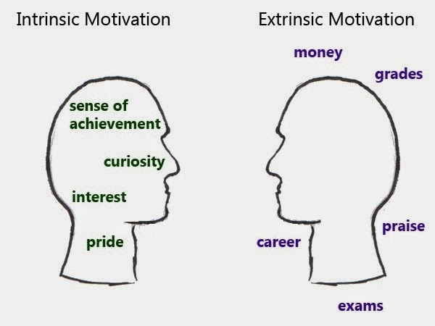
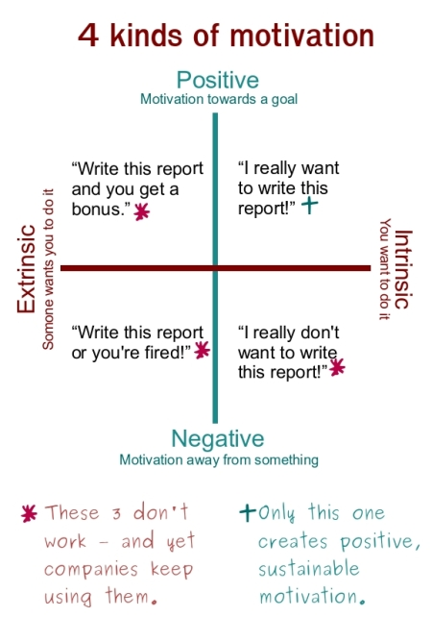
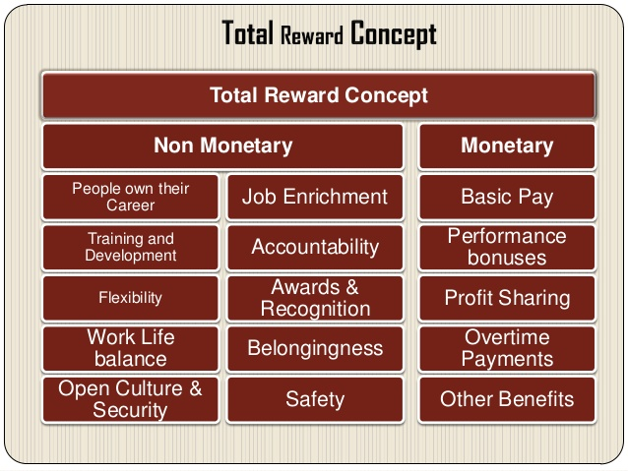
Kinds of Motivation

Slide 8
Goals of Life
SUCCESS =
DREAMS +EFFORTS + TIME
Ladders of objects in Life
Your positioning in the life
Your positioning into society
HAPPINESS
Advertisement of Bajaj Avenger – rat and cat race…..

Slide 9
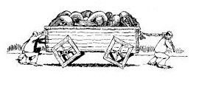
Frustration – Getting over it
Four wheel You tube video on square wheel car drive
Remedies for frustration
Hobbies
Listen to music/videos
Listen to thought leaders/videos
Meditation , take a walk, go to nature
Spend time with friends
Meet your ideals
Go through successful memories

Slide 10
Thumb Rules – to remain motivated
Never expect too much too soon
Set realistic goals - Know what you want in life
Fulfill your promises
Do not imitate anyone but learn from everyone
Keep stress at a bay
Always have a plan B
Accept responsibility for the things you do and think .

Slide 11
Performance - success

Slide 12
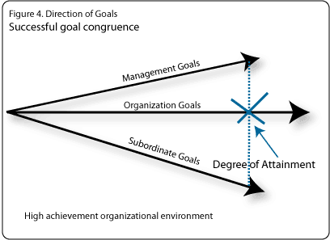
Goal Congruence

Slide 13
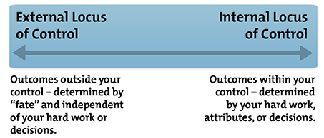
Exercise LOC and Motivation
Any Locus of Control Test available on Web Engine
LOC Key

Slide 14
Think BIG ……
Discussion

